Slide 1
MILESTONE 1 · DISCOVER & DEFINE · 7 MIN
WashBot
Presenting: [Member A] · [Member B] | Team: [M1] · [M2] · [M3] · [M4] · [M5]
[Mon 3pm]_Milestone 1_Team_[name] · Innovation by Design · AI-Accelerated Ventures
Notes:
Open with the final HMW, not the robot. At least two members present; speakers rotate in later milestones. Every member must be able to answer any question. Deck must be submitted as PPT within 48h, labelled Class_Milestone 1_Team_(name).

Slide 2
RUBRIC CRITERION 1 OF 4 · 25 POINTS
01
Problem opportunity & scope
What we show
Methods
The most common pain points, then one HMW that addresses the top three
Common pain points → top three by frequency → HMW statement
Two slides · about 1:30 · Divider: move on quickly
Notes:
Section divider: advance straight through. One sentence at most, for example: we start from the pains housemates mention most, then show the one HMW that tackles the top three. Criterion 1 is worth 25 points.

Slide 3
C1 · PROBLEM & SCOPE (25) · METHOD: COMMON PAIN POINTS → TOP THREE → TEAM HMW
Three common pains, and how people cope today
Pain point | How people cope today | Evidence so far | Link
Walking to the washer only to find it busy | • Walk over and check • Ask in the house chat • Listen for the machine • Wait next to it | [__] of [__] interviewees · [survey %] | [notes / survey link]
Finished loads left sitting in the machine | • Own phone timer • Chat reminders • Take clothes out and leave them on top • Note on the machine | [__] of [__] · [minutes idle, observed] | [notes link]
Nobody knows whose load it is | • Ask everyone in the chat • Knock on doors • Leave it and complain later • Paper sign-up sheet | [__] of [__] · [quote] | [notes link]
~0:30 · Ranked by how many people feel it and how often · Today's workarounds feed the benchmark in section 03
Notes:
Walk through the three pains housemates mention most, then move to the HMW that tackles all three. The middle column lists what people already do today, not ideas the team could build: listing our own solutions here would make the problem framing solution-led, which the rubric penalises, and solution ideas belong to the Ideate stage after Define. These workarounds are also the non-consumption and indirect alternatives for the benchmark. Evidence: fill the counts from interviews and the survey. Link: point to the notes or survey results in the team repository.

Slide 4
C1 · PROBLEM & SCOPE (25) · METHOD: PRIORITISED NEED → HMW
OUR HMW
How might we help people who share one washer or/and dryer with 5+ housemates know when the machine is free and whose load is inside, and get finished loads collected on time, without walking over to check or chasing each other?
Who
Why it matters
In scope
Out of scope
Residents of shared rented flats and co-living units where 5 or more people share one washer, often housemates who are not close
[__] wasted trips / person / week
Machine status, load owner, collection reminders; one washer + dryer per household; no rewiring of the machine
Payment, coin laundromats, large dorm laundry rooms, controlling the machine, booking and usage records
[__] min finished loads sit idle
Source: interviews + survey [date]
~1:00 · Opportunity: shared room rentals and co-living in Singapore [size + source] · Frugal check: why a group chat or paper sheet is not enough
Notes:
The HMW has no product in it. Who: keep it narrow, 5+ people per machine in shared rented flats; the hostel and worker-dorm contexts are out of scope for now because laundry rooms there have many machines and a different buyer. Why it matters: replace the placeholders with numbers from the survey and interviews, never estimates without a source. Opportunity: add one sourced figure on room rentals or co-living in Singapore. Frugal-lens answer: the current fixes (group chat, walking over, notes taped on the machine) exist but people ignore them, which is exactly the compliance problem to probe in interviews.

Slide 5
RUBRIC CRITERION 2 OF 4 · 35 POINTS · HEAVIEST WEIGHT
02
User & stakeholder research
What we show
Methods
Who we engaged, repeated rounds, insights, what changed
Interviews · Follow-up rounds · AEIOU · Insight statements · Journey map
Six slides · about 2:30 · Divider: move on quickly
Notes:
Section divider: advance straight through. This is the heaviest criterion at 35 points, so tell the judges the evidence is coming: numbers, rounds and one pivot.

Slide 6
C2 · STAKEHOLDER ENGAGEMENT (35) · METHOD: INTERVIEWS + OBSERVATION + LEAD USERS
Who we engaged, and what each group told us
Stakeholder | Who exactly (role) | # people | Method | Key takeaway
Primary users | Tenants sharing one washer with 5+ housemates | [__] | Semi-structured interview + survey | [main pain confirmed / not]
Lead users | The housemate who does the most laundry or already runs a schedule / chat reminders | [__] | Interview + observation | [workaround they built]
Buyers | Live-in landlord or master tenant | [__] | Interview | [would they pay? why]
Operators | Property manager of several rental units or co-living staff | [__] | Interview | [complaints they handle]
Non-adopters | Housemates who ignore sign-up sheets and chat rules | [__] | Interview / AEIOU | [why they skip steps]
Total |  | [__] | [__] methods | [one-line summary]
~0:30 · Ethics: consent before recording, participants anonymised P01–P[__]
Notes:
Rubric warns: never say we spoke to many users without numbers or artifacts. Dates and rounds are on the next slide. Primary users are typical tenants who have the problem; lead users feel it most or earliest and have often built their own workaround, which is why the Week 2 lecture recommends them. # is the number of people engaged in each group; the total must match the Research Log. Include adjacent stakeholders: payers, gatekeepers, operators, non-adopters.

Slide 7
C2 · STAKEHOLDER ENGAGEMENT (35) · METHOD: AEIOU OBSERVATION
What we saw on site at [location]
A
E
I
O
U
Activities
Environment
Interactions
Objects
Users
[observed detail]
[observed detail]
[observed detail]
[observed detail]
[observed detail]
[Photo of the real context]
[Photo of a workaround]
~0:20 · Record what users actually do, not what we assume they do
Notes:
Direct evidence: photos, AEIOU notes. Keep it visual; do not read every note.

Slide 8
C2 · STAKEHOLDER ENGAGEMENT (35) · METHOD: INSIGHT STATEMENTS
Three insights with creative tension
Insight 1
Insight 2
Insight 3
[User] needs [..] BUT [..] because [..].
[User] actually [..].
[User] needs [..] YET [..] because [..].
"[verbatim quote]" · P0[_]
"[verbatim quote]" · P0[_]
Seen in [__] of [__] participants
"[verbatim quote]" · P0[_]
Seen in [__] of [__] participants
Seen in [__] of [__] participants
~0:45 · Insight = observation + tension + reason
Notes:
Use the two insight structures from Week 3: needs... BUT/YET... because, and ...actually.... Quotes must be real and verbatim. 2–3 quotes in total is enough.

Slide 9
C2 · STAKEHOLDER ENGAGEMENT (35) · METHOD: FOLLOW-UP INTERVIEWS + RAW → REFRAMED INSIGHT
We went back to the same people, and it changed our view
ROUND 1 · [date]
ROUND 2 · [date]
NOW
[__] interviews + observation: [who]
→
Back to [__] of the same people + [new group] · follow-up / role-play
→
HMW v[__] · focus on [..]
We assumed (before) | Users showed us (evidence · round) | So we changed (after)
[initial assumption] | [quote / observation, P0x] · R1 | [HMW / segment / scope change]
[initial assumption] | [quote / observation, P0x] · R2 | [change]
OUR PIVOT
When [P0x] told us "[..]", we moved from [old focus] to [new focus].
~1:00 · Repeated engagement (≥2 rounds with the same stakeholders) and what it changed: the key slide for the 27–35 band
Notes:
This slide merges the old round-by-round trail with the before and after table. Top row: prove repeated engagement by naming the rounds, dates and which participants were revisited (Week 3: follow-up interviews or role-play to test insights and prioritise needs). Table: each change cites the evidence and the round it came from. Pivot box: one concrete piece of feedback and what it changed in the HMW, segment or scope. Rubric: the team clearly shows how feedback and design processes changed its understanding of the problem.

Slide 10
RUBRIC CRITERION 3 OF 4 · 20 POINTS
03
Existing solutions & market landscape
What we show
Methods
What people use today and the gap nobody fills
Comparison matrix · Perceptual map · Strategy canvas · ERRC grid · Opportunity gap
Five slides · about 1:35 · Divider: move on quickly
Notes:
Section divider: advance straight through. Criterion 3 needs direct, indirect and non-consumption alternatives, honest comparison and one gap sentence.

Slide 11
C3 · BENCHMARKING (20) · METHOD: COMPARISON MATRIX
How current options meet the needs users ranked highest
Alternative | Type | [Need-based criterion 1] | [Criterion 2] | [Criterion 3] | Price | Source
[..] | Direct | [value] | [value] | [value] | S$[__] | [pricing page]
[..] | Direct | [value] | [value] | [value] | S$[__] | [reviews]
[..] | Indirect | [value] | [value] | [value] | S$[__] | [docs]
[..] | Indirect | [value] | [value] | [value] | S$[__] | [..]
[manual workaround] | Non-consumption | [value] | [value] | [value] | [time cost] | P0x
~0:25 · Criteria come from ranked needs · Evidence per cell · Say where an alternative beats us
Notes:
Label all three categories. Avoid a matrix of green ticks for us and red crosses for everyone else. Use measured values (metrics) rather than ticks where possible, as in Week 3 benchmarking on metrics.

Slide 12
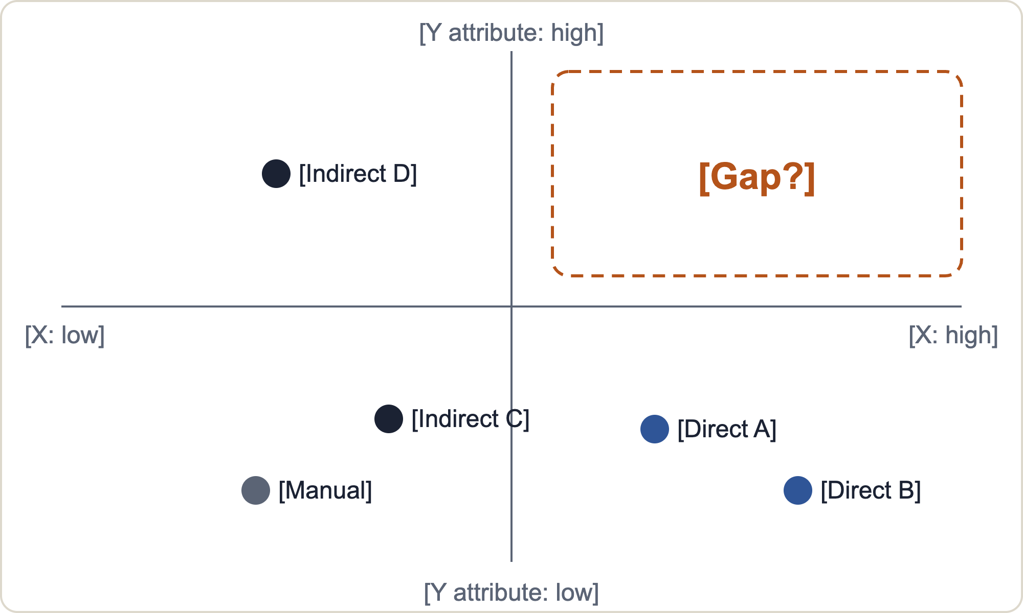
C3 · BENCHMARKING (20) · METHOD: PERCEPTUAL MAP
Where users place today's options on what matters most
How we built it
1. Axes = our two top-ranked user needs
2. Options = direct, indirect and manual
3. [__] users placed each option 1–5
4. Checked with [__] participants
Read it
● Direct ● Indirect ● Manual workaround
Empty space + unmet need = candidate gap. Perceptions are subjective, so name the sample.
~0:20 · Axes come from ranked needs, not from what is easy to draw · Source: perceptual map method (Appinio)
Notes:
Perceptual map: plot the options on two attributes that matter to users, using how users perceive them, not how the team sees them. Steps from the reference: set the objective, pick a few relevant attributes, choose options to compare (direct competitors plus the alternatives people actually consider), collect data with surveys, interviews or observation from a representative sample, plot, then validate with stakeholders. For a class project a scatter chart in Excel is enough. Axes: reuse the two highest-ranked needs from the needs ranking. Honest limits: perceptions are subjective, a 2D map simplifies reality, and a small sample needs to be stated. The empty quadrant is only a hypothesis until an unmet need from interviews sits in it. Reference: appinio.com/en/blog/market-research/perceptual-map

Slide 13
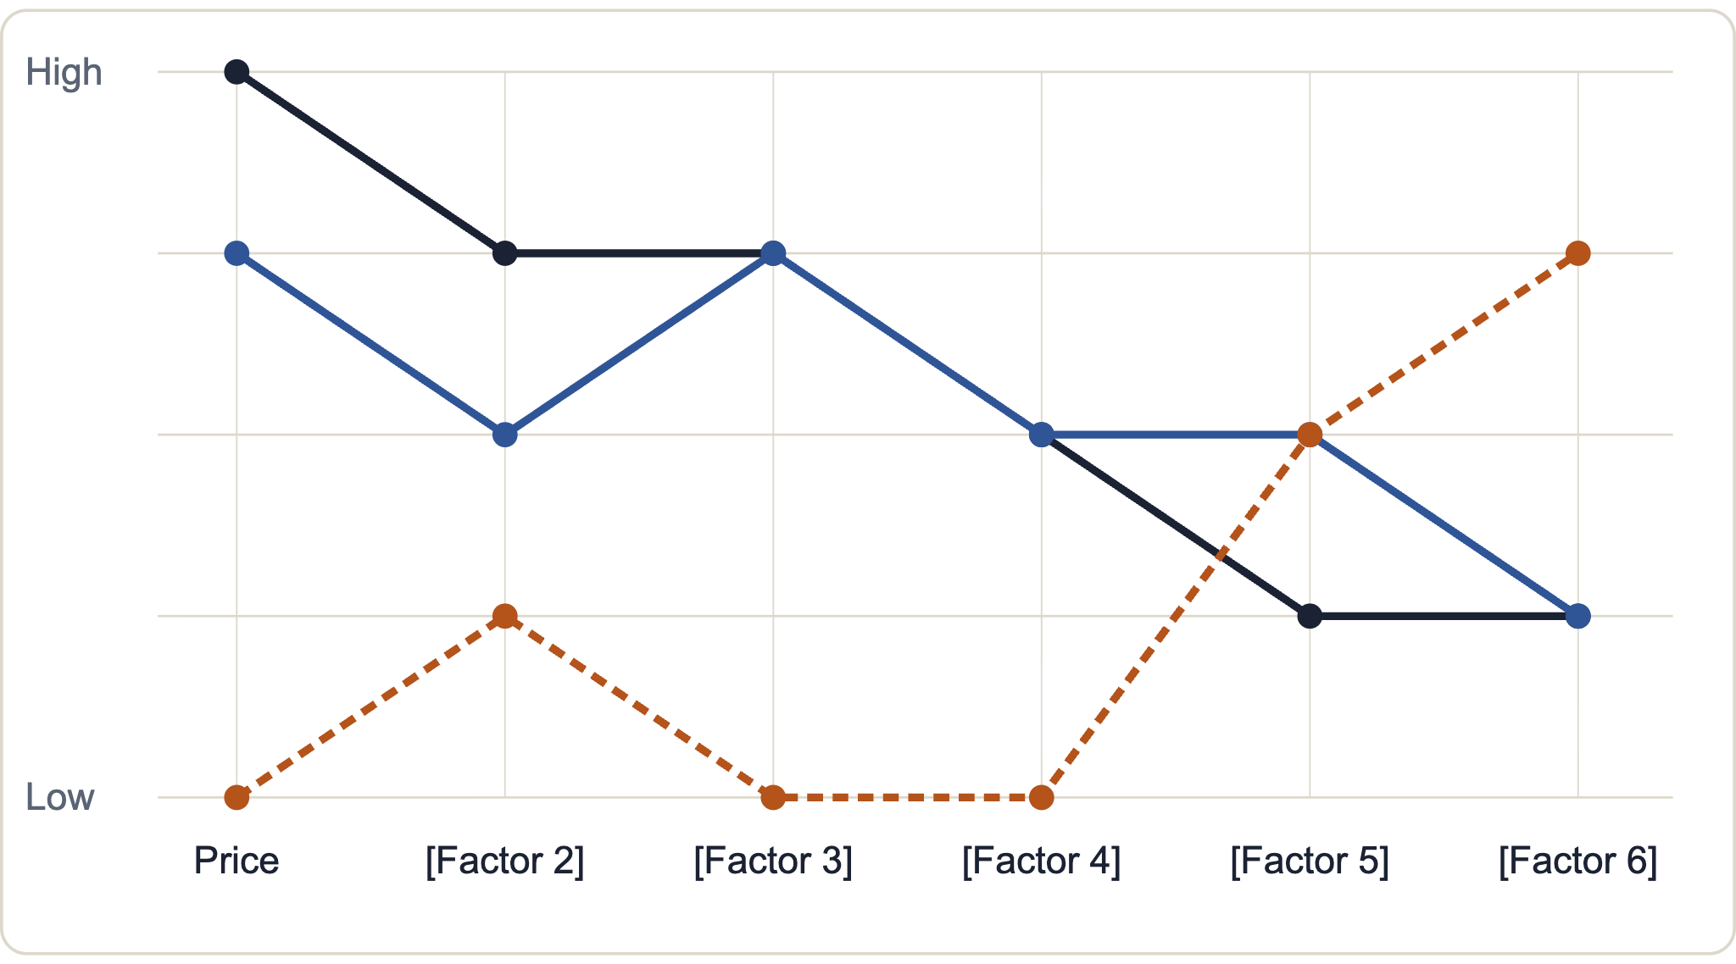
C3 · BENCHMARKING (20) · METHOD: STRATEGY CANVAS (AS-IS)
What the market competes on today
How to draw it
1. Name the industry
2. List the factors it competes on, starting with price
3. Rate each player 1–5 per factor
4. Connect the dots into a value curve
5. Compare with the strongest competitor
Read it
━ Industry leader
━ [Alternative B]
╍ Manual workaround
Curves that move together = where everyone competes. Low everywhere = where nobody invests.
~0:20 · Factors = what users said matters (need ranking) · Source: Blue Ocean strategy canvas
Notes:
Strategy canvas: horizontal axis lists the factors the market competes on (start with price), vertical axis is the offering level buyers receive, 1 low to 5 high. Plot the industry leader or strongest competitor, connect the dots to get its value curve, then add other players. The reference says most of the work is in step 2, choosing the right factors, so take them from your ranked user needs and the benchmark criteria rather than guessing. This is the as-is canvas for Milestone 1. A to-be canvas, the new value curve, belongs to later milestones once concepts exist. Reference: blueoceanstrategy.com/blog/strategy-canvas-template

Slide 14
C3 · BENCHMARKING (20) · METHOD: ERRC GRID
Which factors to drop, cut, lift or invent
Eliminate
Reduce
Taken for granted, but users don't value it
Over-served versus what users actually need
• [factor] · evidence P0x
• [factor] · evidence P0x
• [factor] · evidence P0x
• [factor] · evidence P0x
Raise
Create
Under-served: users want more than they get
Something no alternative offers yet
• [factor] · evidence P0x
• [factor] · evidence P0x
• [factor] · evidence P0x
• [factor] · evidence P0x
Eliminate + Reduce cut cost · Raise + Create lift value → the shape of a new value curve
~0:15 · Work at factor level, from ranked needs and the canvas, not product features · Source: Blue Ocean ERRC grid
Notes:
ERRC grid (Four Actions framework): for the factors on the strategy canvas decide what to eliminate, reduce, raise and create. The aim in the reference is an offer that is very different from the competition: cheaper because some factors are eliminated or reduced, yet unique because others are raised or created. Its worked example is an influencer marketing platform that removed searching, approving and negotiating with influencers and created a pay per click model. Caution for Milestone 1: the rubric penalises solution-led work, so write ERRC entries as market factors backed by evidence (P0x, benchmark row), for example time spent or skill needed, not as features of a device. If time is short, move this slide to the appendix and keep one sentence of it in the opportunity gap. Reference: effectivesoftwaredesign.com/2021/01/18/the-blue-ocean-eliminate-reduce-raise-create-errc-grid

Slide 15
C3 · BENCHMARKING (20) · METHOD: OPPORTUNITY GAP
The opportunity gap
No existing option [does X] for [segment], because [why the gap persists].
Where others win
Why the gap persists
Evidence
[alternative] is better at [..]; we won't compete on that
[cost / regulation / tech / incentive reason]
[empty area on the perceptual map and canvas]
[interview P0x]
~0:15 · One sentence, one reason
Notes:
Stated in one sentence plus why nobody has solved it yet. Review scraping (Week 2 data-driven approach) makes a strong evidence source here. Link it to the empty quadrant on the perceptual map and the low-investment factors on the strategy canvas.

Slide 16
RUBRIC CRITERION 4 OF 4 · 20 POINTS
04
Needs, requirements & early venture hypothesis
What we show
Methods
Ranked needs, traceable requirements, segment, value proposition, WTP
Needs ranking · Needs to metrics to specs · Early adopter · Value prop · WTP test
Four slides · about 1:50 · Divider: move on quickly
Notes:
Section divider: advance straight through. Criterion 4 rewards traceability: every requirement points back to a need and its evidence.

Slide 17
C4 · NEEDS & REQUIREMENTS (20) · METHOD: AFFINITY CLUSTERING + NEEDS RANKING
What users need, ranked
HYPOTHESIS · validate in interviews
Know the state from afar
Collection & etiquette
Effortless to use
Demands
*** Finished loads are cleared quickly for the next person
*** Works even when users skip extra steps
Renter-friendly: no rewiring, removable
*** Users know whether the washer is free without walking to it
** Alerts arrive on a channel they already use
Privacy: show room no. or last 4 phone digits, not full name
** Users know whose load is in the machine
** Users know when their own load has finished
! Users avoid awkward confrontation with housemates
Low price per household: S$[__]
*** critical · ** important · ! latent · Need statements say what, not how · Ranking to be confirmed by [__] interviewees
~0:30 · From team pain list; each need gets ≥2 supporting participants before the pitch
Notes:
These needs come from the team's own pain list, so the slide is labelled as a hypothesis until interviews confirm them. After the interviews, add the participant codes next to each need, re-rank with the stars, and remove any need nobody mentions. 'Works even when users skip extra steps' comes from the known behaviour problem: an extra step makes people lazy to comply. The privacy demand answers the question of whether a full name is needed: a room number or last four digits is configurable.

Slide 18
C4 · NEEDS & REQUIREMENTS (20) · METHOD: NEEDS → METRICS → TARGET SPECS
Every requirement traces back to a need
Requirement (metric) | ← Need | ← Evidence / benchmark | Marginal / ideal | Priority
Start/end of cycle correctly detected (% of loads) | Know if free *** | [bench test __ loads] · timer-only fallback | 90% / 98% | Must
Time from cycle end to alert (min) | Know when my load is done ** | [test] | < 3 / < 1 | Must
Extra actions per load for the user | Works if steps are skipped *** | Observed: people skip sign-up sheets [P0x] | ≤ 1 / 0 | Must
Install time, tools needed | Renter-friendly (demand) | Landlord interview [date] | < 15 min / < 5 min, no tools | Must
Owner shown as room no. / last 4 digits | Privacy (demand) | PDPA · [P0x] | configurable | Should
Queue, booking, usage records | — | not needed to answer the HMW | — | Out of scope
KPI | Baseline (measure this week) | Target
Wasted trips to a busy machine | [__] / person / week | −[__]%
Minutes a finished load sits uncollected | [__] min | < 15 min
~0:40 · Detection accuracy is our known technical risk, so it is a measured requirement, not a promise
Notes:
The two known limitations become explicit requirements: detection accuracy (the vibration algorithm may misread pauses in the cycle) and extra user steps (people skip workflows). Fill the baselines from interviews and a short observation, then run a small bench test on the washer at home for the accuracy row. Queue and usage records are deliberately out of scope for Milestone 1.

Slide 19
C4 · SEGMENT & VALUE PROPOSITION (20) · METHOD: EARLY ADOPTER + VALUE PROP
Who feels it first, and who pays
HYPOTHESIS · validate in interviews
Users
Early adopter / buyer
Later
Housemates in a shared flat, 5+ per washer, often not close friends
The live-in landlord or master tenant who already fields laundry complaints
Operators of several rental units or co-living buildings
Feel the pain daily
Many machines, one buyer
One decision maker · can make it a house rule
VALUE PROPOSITION
For landlords of shared flats where 5+ tenants share one washer, a stick-on status tag shows every tenant whether the machine is free and whose load is inside, and reminds them to collect it, unlike group-chat messages and notes on the machine, with no rewiring and one scan per load.
~0:30 · Users ≠ buyer: we tell the story from the tenants' pain and sell to the landlord
Notes:
Two ways to tell the story. Tenants as buyers: they feel the pain and are easy to interview, but splitting a small cost among housemates who are not close is hard and nobody owns the decision. Landlord as buyer: one decision maker who can make scanning a house rule, which helps the compliance problem, and later scales to multi-unit operators; the risk is that landlords only feel the pain through complaints. Recommended: tell the problem from the tenants' side and test the landlord as the first buyer this week. If the landlord interview shows no interest, switch to tenants as buyers and say so on the shift slide.

Slide 20
C4 · WILLINGNESS TO PAY (20) · METHOD: WTP HYPOTHESIS + TEST PLAN
What they would pay, and how we will find out
HYPOTHESIS · validate in interviews
Offer
Price hypothesis
Who pays
Anchors
One stick-on tag per machine + a one-page setup guide
S$[__]
Landlord or master tenant
Smart plug price: S$[__]
Fallback: split among housemates
Cost of complaints / tenant turnover: [landlord]
No subscription for v1
per tag, one-off
How we test it this week
1. Ask our landlord and 2–3 others what they spend today on laundry fixes and complaints
2. Van Westendorp price questions in the housemate survey (too cheap / cheap / expensive / too expensive)
3. Ask for a pre-order or letter of intent at our target price
~0:30 · Bill of materials must stay under the price with margin: BOM S$[__] per tag
Notes:
The rubric wants a price point, who pays and evidence. Anchor on what the buyer already spends, not on what they say they would like. Look up a smart plug price and the tag's bill of materials (ESP32, 20x4 LCD, vibration sensor, buzzer, magnets, case) so the price is credible. Van Westendorp is an outside method; mention it by name only if asked.

Slide 21
NEXT · TOWARDS MILESTONE 2
What we'll do next
Validate
Ideate
Constraints we know
[riskiest assumption to test]
Multiple distinct concepts (mechanical, digital, hybrid) answering our HMW
[technical / cost / safety limits]
~0:15 · Validate, ideate and known constraints
Notes:
Mention technical limitations here, not in the graded sections. Keep under 15 seconds.

Slide 22
MILESTONE 1 · DISCOVER & DEFINE
Thank you
Questions & answers
Research repository: [link]
Notes:
Leave this on screen during Q&A. Every member should be able to answer any question. Submit the deck as PPT within 48 hours, labelled Class_Milestone 1_Team_(name).

